Slide 1
Statelet-Based Efficient and Seamless NFV State Transfer
Shraddha Pawar
Summer Term 2020

Slide 2
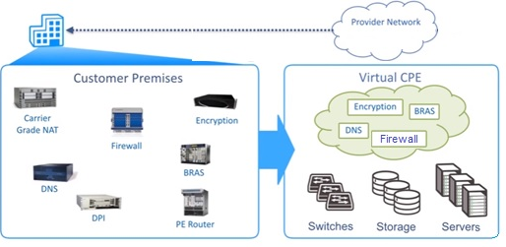
Introduction
What is NFV (Network Function Virtualization )?
Statelet approach
Slim Migration System(SliM)
Reference: https://medium.com/@blogstevej327stuff/what-is-network-function-virtualization-nfv-a3bcd98d891f

Slide 3
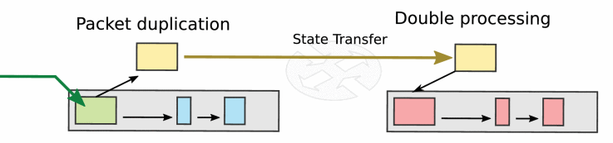
Problem
Duplication-based mechanism: packet buffering
NF Failure : unexpected delay
Duplication-based transfer[1]

Slide 4
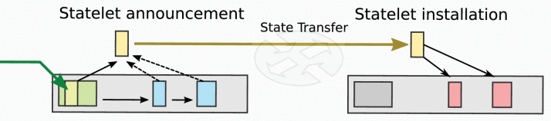
Approach
Statelet Interface
Methods to use statelet approach:
Network address translation
Signature-based intrusion detection
Vpn concentrator
Statelet-based transfer [1]

Slide 5
Implementation
Migration System: Complete and Partial Migration
State Migration:
Drawback: Bandwidth Capacity

Slide 6
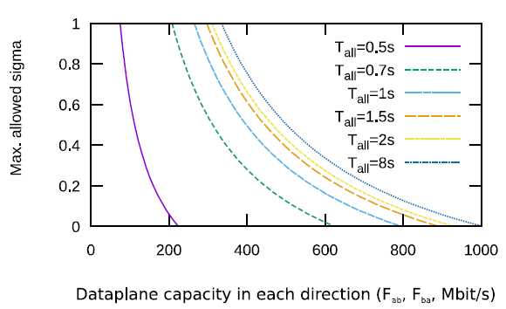
Solution
Statelet Factor [σ] : ratio of the average statelet traffic volume and average volume of the packets.
SliM Migration
“Dataplane capacity” in each
direction(Mbits)[1].

Slide 7
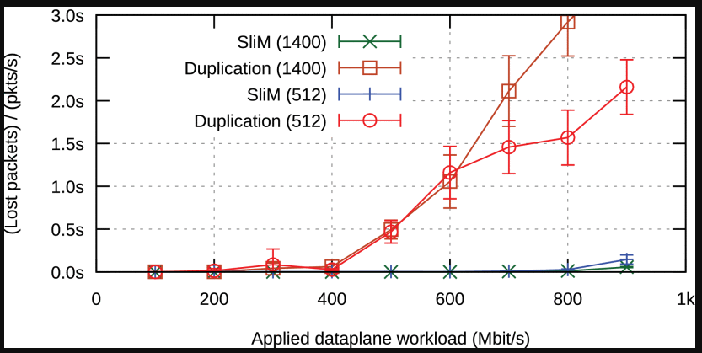
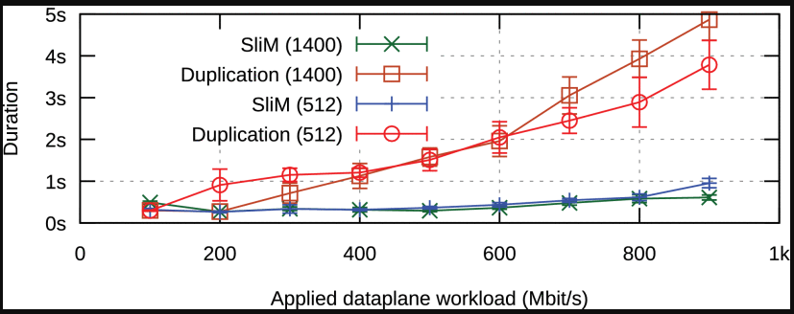
Results
“Seconds of packet loss”for 1400 byte ,NAT NF. [1]
, NAT NF.s
“Migration duration” for 1400-byte and 512-byte packet, NAT NF.[1]

Slide 8
Conclusion
SliM technique is bandwidth efficient.
Higher performance rate and reduces packet loss.

Slide 9
Future Work
Extend SliM with partial state migration.
Show SliM with its feasibility in different types of ways.

Slide 10
References
L.Nobach, I.Rimac, V.Hilt and D.Hausheer. "Statelet-Based Efficient and Seamless NFV State Transfer"}.In IEEE Transactions on Network and Service Management, vol.14,no.4, pp.964-977, Dec 2017. [1]
https://medium.com/@blogstevej327stuff/what-is-network-function-virtualization-nfv-a3bcd98d891f

Slide 11
Thank You

